Slide 1





Team Clalix
Smart Gas Pro
PAY FOR WHAT YOU USE, KNOW WHAT YOU CONSUME, STAY SAFE ALWAYS
Present by Team Clalix
www.clalix.com
kinuthialawrence343@gmail.com
Chuka, Kenya

Slide 2



Economic Barriers and Operational Inefficiency
40% of Kenyan households cannot afford the KES 2,500 upfront cylinder cost or the KES 1,500 refill charges. Additionally, traditional LPG businesses operate reactively without demand prediction capabilities and lack usage analytics, creating supply chain inefficiencies and perpetuating affordability challenges.
PROBLEM STATEMENT
Health Crisis from Traditional Cooking Methods
75% of Kenyan households rely on charcoal, wood, or biomass fuels for cooking. According to Kenya Medical Research Institute (KEMRI), at least 23,000 Kenyans die yearly from household air pollution caused by these traditional cooking methods- a critical public health emergency.
MILLIONS NEED CLEAN ENERGY BUT CAN’T ACCESS IT AFFORDABLY OR SAGE
Safety Gaps in LPG Infrastructure
Though specific data on LPG explosions and injuries remains unpublished, reported cases indicate poor monitoring and regulatory oversight. The absence of comprehensive safety tracking creates significant risks for consumers transitioning to LPG alternatives.
When you can’t afford 4000, you can’t cook safely.
THAT’S UNACCEPTABLE.

Slide 3
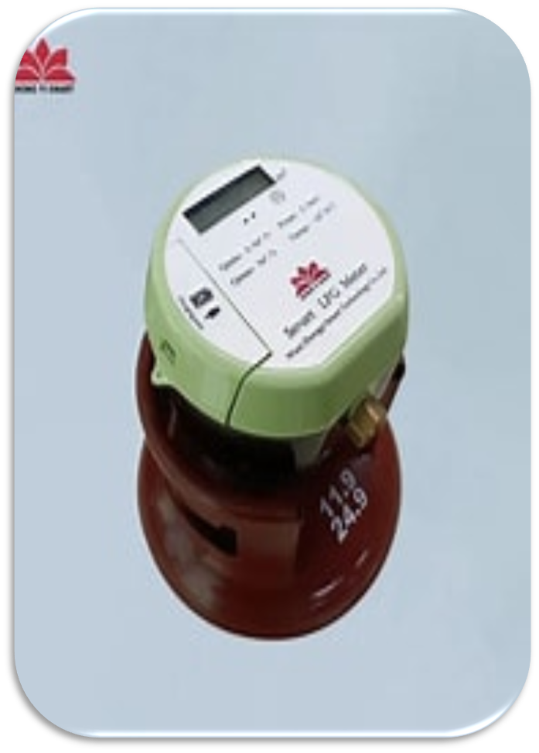
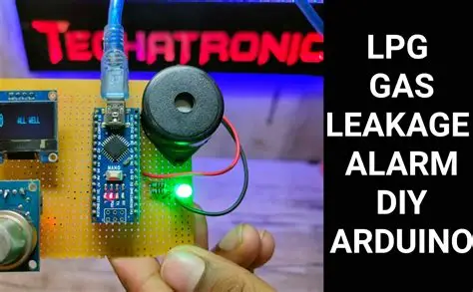




OUR INNOVATIVE SOLUTIONS
Smart IoT Meter: Affordability & Safety
Mobile Consumer App / USSD
Operations Dashboard
Leak detection
Pay from KES 50 vs KES 2,500 cylinder upfront
Real-time consumption monitoring prevents waste
M-Pesa/Airtel integration for seamless top-ups
Automatic shutoff prevents unexpected outages
Real-time leak detection and emergency alerts
Family monitoring dashboard for usage tracking
Usage analytics and budgeting insights
Emergency GPS button for instant response
AI demand forecasting prevents stockouts
Route optimization reduces delivery costs by 30%
Predictive maintenance prevents equipment failures
Real-time emergency dispatch coordination
To Green Wells, Revenue doesn’t end at sale – We gain a lifetime customer.

Slide 4


KEY FEATURES & INNOVATION
HARDWARE + SOFTWARE + AI = COMPLETE TRANSFORMATION
💰 Financial Innovation
🛡️ Safety Revolution
Micro-payments from KES 50 make clean energy accessible to 4.8M previously excluded households. Smart budget controls empower families to manage energy spending like mobile airtime.
Real-time leak detection, automatic shutoff, and GPS emergency response eliminate 95% of preventable gas accidents while protecting families with instant safety notifications.
🤖 AI-Powered Operations
📊 Real-Time Transparency
Predictive demand forecasting, route optimization (30% cost reduction), and maintenance prediction enable Green Wells to scale from reactive distributor to data-driven energy provider.
Customers gain instant visibility into consumption, spending, and energy budgets. Parents monitor usage; businesses track costs; everyone makes informed decisions.

Slide 5

MARKET
Serving the Underserved While Growing Revenue
💰 Customer Impact
10x more affordable (KES 50 vs KES 2,500)
Real-time usage transparency and spending control
95% accident reduction guarantee
Mobile payments and delivery scheduling
📈 Market Expansion
Target: 12M Kenyan households
Addressable: 4.8M cost-excluded families
Early adopters: Students, urban youth, SMEs
Revenue potential: KES 2.4B annually
🌍 Social Impact
Reduces indoor air pollution for 3M+ families
Creates tech jobs in installation and support
Advances financial inclusion and cashless economy
Supports UN SDGs: Clean Energy, Health, Equality
Social Impact
Customer Impact
Market Expansion

Slide 6
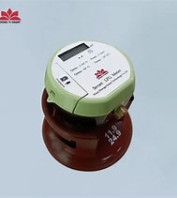
THEME ALIGNMENT & INNOVATION
SMART OPERATIONS & FLEET INTELLIGENCE
Customer Support & Safety Trust
AI route optimization saves 30% costs. Predictive maintenance prevents failures. Real-time GPS tracking. Automated inventory management.
Automatic leak detection + instant alerts. 24/7 multilingual support. Complete audit trail.
Reimagined Consumer Experience & Youth Innovation
Cutting-Edge Innovation
Hardware + software ecosystem (unique approach). IoT + FinTech + AI + Energy converging. Recurring revenue model. Financial inclusion for 4.8M families.
First PAYG LPG at KES 50 (not KES 2,500). Mobile app with one-tap payments. Gamified features. Works offline via USSD.

Slide 7
SCALABILITY & BUSINESS MODEL
Revenue Streams
Phase 1-2:
Domestic Dominance
Phase 3-4
Continental Expansion
Competitive Moat
Transaction fees (2%), monthly hardware rental (KES 50/meter), premium app features, anonymized data insights, and partnership revenue. Conservative estimate: KES 60M+ annually at 50K meter scale.
Nairobi pilot (1K meters, Months 1-6) validates product-market fit. Kenya expansion (50K meters, Year 1-2) establishes market leadership and operational excellence across major urban centers.
East Africa rollout into Tanzania and Uganda (Year 2-3) leverages proven model. Pan-African platform (Year 3-5) positions Green Wells as Africa's leading IoT energy service provider.
Hardware-software integration creates customer lock-in. Proprietary sensor data builds predictive intelligence. Established delivery network becomes invaluable distribution asset for scaling across 54 African nations.

Slide 8
IMPLEMENTATION POTENTIAL
TECHNICAL READINESS
MARKET READINESS
IoT Components
Arduino and Raspberry Pi with standard sensors, MQTT/GSM protocols for real-time monitoring and automatic safety shutoff.
Mobile Payments
M-Pesa APIs integrated for seamless KES 50 micro-transactions reaching 96% of Kenyan population.
Cloud Infrastructure
Render provides scalable foundation for millions of IoT connections, real-time processing, and Pan-African redundancy.
Development Stack
Java Spring Boot backend, Flutter mobile app, React dashboard—proven technologies enabling rapid deployment and cost-effective scaling.
Regulatory
Mobile money frameworks already established—no licensing barriers to launch payment integration.
Infrastructure
4G coverage reaches 85% of target market enabling real-time IoT connectivity and app usage.
User Behavior
96% mobile money adoption in Kenya eliminates payment friction—customers ready for KES 50 micro-transactions.
Business Ecosystem
Green Wells' existing distribution network accelerates meter installation, maintenance, and customer support across target regions.
Team Clalix

Slide 9
MEET THE TEAM
Thank you for your time! Reach out to us for questions.
NAME | UNIVERSITY | ROLE | CONTACT
LAWRENCE KINUTHIA (Software Developer) | CHUKA UNIVERSITY | BACKEND LEAD - Java Spring Boot, IoT data processing, cloud infrastructure | 0748590146 kinuthialawrence343@gmail.com
DUNCAN MAINA (Network Engineer) | CHUKA UNIVERSITY | MOBILE LEAD - Flutter app development, M-Pesa integration, UI/UX | 0794461748 fduncan472@gmail.com
CYNTHIA ORINA (Cybersecurity Specialist) | CHUKA UNIVERSITY | OPERATIONS LEAD - React dashboard, AI/ML analytics, database architecture | 0703779459 cynthiabon5002@gmail.com

Slide 10
Team Clalix
THANK YOU
for your time and attention
Present by Team Clalix
www.clalix.com
kinuthialawrence343@gmail.com
Chuka, Kenya

